Slide 1
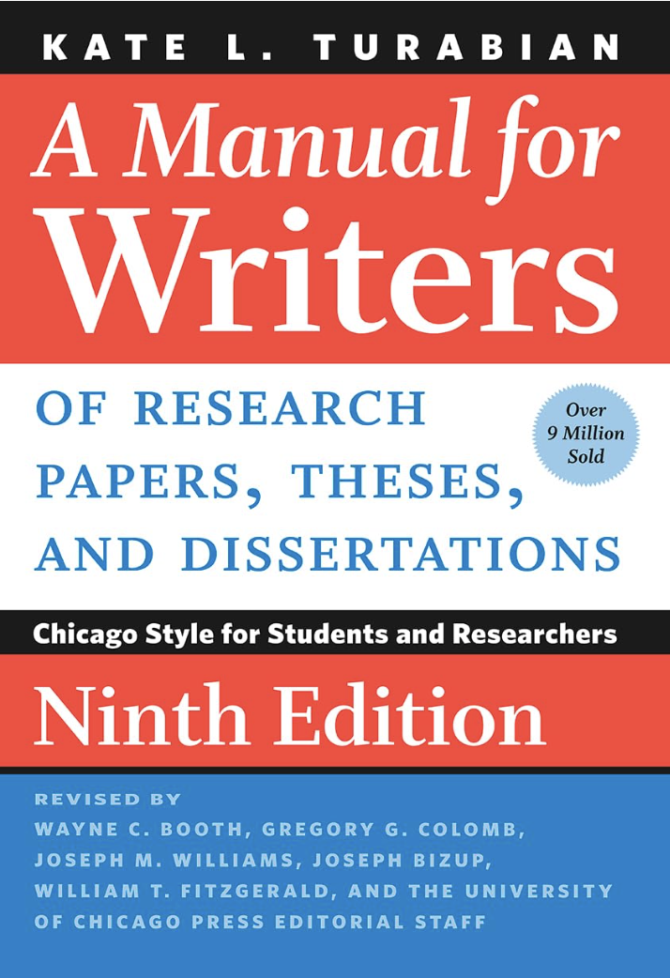
Tips on Turabian
An overview of
A Manual for Writers, 9th ed., 2018
Completely redesigned: April 2024
Latest update: September 2024
Jana Matthews, Denver Seminary Writing Center Coordinator, with input from Writing Center Staff

Slide 2
What is “Turabian”?
“Turabian” is an abbreviated way to refer to A Manual for Writers of Term Papers, Theses, and Dissertations by Kate L. Turabian.
The Turabian manual provides formatting guidelines for structuring your paper and citing your sources.
The Turabian manual is organized into the following three sections:
Part 1: Research and Writing (academic/scholarly)
Part 2: Source Citation (footnotes, bibliographies)
Part 3: Issues of Style (editorial style, quotations)
In this presentation, section numbers from the manual are provided for further reference.
• E.g., “17.1” refers to the section on citing books.

Slide 3
How can I access the manual?
The Turabian manual is available in many formats.
Hard copies are available on reserve and in the reference section of the Denver campus library. (Pro tip: students may borrow a copy overnight if it is checked out within two hours of closing!)
The library provides online access to both Turabian and The Chicago Manual of Style, which is the professional version of Turabian. You may access Turabian here, and CMOS here.
Turabian is also available on Kindle.
Note: While the Writing Center offers many “quick-guide” resources on our Resources page to help students understand basic Turabian formatting, we recommend that students familiarize themselves with and consult the manual itself.

Slide 4
Which Turabian Citation Style to Use
Notes-Bibliography
Denver Seminary requires the use of the notes-bibliography style, which is used in the humanities. (The alternative is author-date, which is used in most sciences.)
Notes-bibliography style uses footnotes in the body of the paper to cite sources and lists the sources used in a bibliography at the end of a paper.
Notes-bibliography uses parenthetical citations only when citing scripture (see slide 13 for more on citing scripture).

Slide 5
Notes- Bibliography
Highlights of Notes-Bibliography Style
Superscripts: Indicate you have used a source by placing a superscript number at the end of the sentence in which you quote or refer to that source. Superscripts always follow punctuation:
Through “fostering the psychospiritual growth and health,” we can transform the depths of a person.¹
Footnotes: Cite the publication information of that source in a footnote and end with a period:
¹ David Benner, Care of Souls: Revisioning Christian Nurture and Counsel (Ada, MI: Baker Books, 1998), 23.
Shortened cites: If you cite the same source again, use a shortened form with up to four words of the title:
² Benner, Care of Souls, 24.
Ibid.: After a shortened cite, use ibid. (Ibid. is Latin for “in the same source.” The word is not italicized in footnotes.)
³ Ibid.
⁴ Ibid., 25.

Slide 6
Turabian Format Checklist
Pro tip: download “Turabian Formatting Checklist” from the Resources page.
Formatting | Specifications
Font | Times New Roman - black
Body | Font size: 12 pt. Line spacing: double space text, triple space above headings 1-inch margins on all sides Left justified (the right margin should be jagged) Page numbers go in the upper right corner starting on/with page 2.
Block Quotations | Format quotes of five or more lines as block quotations Line spacing: single space quotations with a blank line before and after Indent: all lines are indented ½ inch
Footnotes | Font size: 10 pt. Indent: first line of each footnote is indented ½ inch; end with a period Line spacing: single space within each entry; blank line between entries
Bibliography | Font size: 12 pt. Line spacing: single within each entry, blank line (double space) between entries Indent runover lines ½ inch

Slide 7
What to Capitalize
Capitalize:
the Bible, Holy Bible
the Holy Scriptures
the Word of God
Do not capitalize:
scripture or scriptural
biblical, biblical studies, biblical narrative
Gospel (specific gospel, e.g., Gospel of Mark)
gospel (the content of scripture)

Slide 8
Words and terms from other languages
Italicize:
Foreign language terms and transliterations of Greek and Hebrew.
Examples:
The transliteration for “word” in Greek is logos.
The word for “rest” in the original Hebrew is nuwach.
Do not italicize:
Familiar terms (e.g., de facto, vis-à-vis) or Greek and Hebrew terms when written in Greek and Hebrew letters.

Slide 9
numbers
First number | Second number | Examples
1-99 | Use all digits | 3-10, 71-72, 96-117
100 or multiples of 100 | Use all digits | 100-104, 1100-1113
101-109, 201-209, etc. | Use changed part only | 101-9, 808-33, 1103-4
110-199, 210-299, etc. | Use two digits unless more are needed to include all changed parts | 321-28, 498-532, 1087-89, 1496-500, 11564-615 Based on Table 23.2
To express a range of numbers, such as pages or years, give the inclusive numbers of the sequence with a hyphen (e.g., “45-50”).
If the numbers are spelled out, express the range with the words from and to (e.g., “from three to five”).
Note: never use commas in page numbers.
In general, if you use numerical data infrequently, spell out numbers from one through one hundred.
See 23.1-4 for general guidelines for presenting numbers (e.g., dates, percentages, time, money, etc.).

Slide 10
Headings
Heading Level | Format Example Heading
First level | Centered, Boldface or Italic Type, Headline-style Capitalization Contemporary Art
Second level | Centered, Regular Type, Headline-style Capitalization What Are the Major Styles?
Third level | Flush Left, Boldface or Italic Type, Headline-style Capitalization Abstract Expressionism
Fourth level | Flush left, regular type, sentence-style capitalization Major painters and practitioners
Lengthy papers (6+ pages) generally need headings.
Unless you are writing a very long and complex paper (e.g., 20+ pages, a thesis), one or two heading levels are probably sufficient.

Slide 11
Why Cite Sources?
To avoid plagiarism, which is claiming other people’s work as your own by not documenting your sources, whether intentionally or not.
To give credit where credit is due. Sources deserve credit for the exact contribution they provide.
For more information on plagiarism, along with examples, visit the Resources page and download “Avoiding Plagiarism.”

Slide 12
Citing Specific types of sources
The following slides will provide guidelines, examples, and locations in the Turabian manual for citing common types of sources.
For example, 17.1 provides guidance on citing books; 17.1.3 provides guidance on citing specific editions of books, etc.
Download two reference guides for citing sources on our Resources page:
Citing Common Sources in Turabian
Guidance for Research Papers

Slide 13
Citing the Bible: In-text Citations
Quoting scripture in the text. Put the full reference in a parenthetical cite. Identify the version (17.8.2 and 24.6).
“I will build you up again” (Jer. 31:4 NIV).
Referring to whole chapters or books. Spell out the names of the books (24.6).
Jeremiah 42-44 records the flight of the Jews to Egypt.
The creation story is told twice in Genesis.
Identifying passages by verse. Abbreviate the names of the books (24.6).
In Jer. 31:4 the prophet states, “I will build you up again.”
Note: Never write out the words “chapter(s)” or “verse” after the title of a biblical book, but use the form Matthew 5, or Gal. 5:22-23.

Slide 14
Citing the Bible: Abbreviations
Bible-related abbreviations:
Old Testament (OT), New Testament (NT)
Books of the Bible: use either traditional or shorter abbreviations (pick one or the other and be consistent):
Traditional example: 2 Chron.
Shorter example: 2 Chr
For a list of abbreviations for books of the Bible, see sections 24.6.1 and 24.6.3 in the Turabian manual.
In the regular text of a paper, spell out “verses,” e.g., “In verses 8-10 we read. . . .” But in parentheses or footnotes, abbreviate “verses” as vv. E.g., (vv. 8-10).
Pro tip: download “Citing the Bible in Turabian” and “Guidance for Research Papers” from the Resources page.

Slide 15
Citing the Bible: Versions of the Bible
Parentheses:
Note the version in parentheses using abbreviations:
“Jesus wept” (John 11:35 NIV).
Footnotes:
Footnote the first occurrence and identify the version. Thereafter, only identify the version when you diverge from your primary one. (See footnote example below.)
“Jesus began to weep” (John 11:35).¹
Bibliography
Do not cite the Bible in your Bibliography (17.8.2).
Exception: If citing study notes or other portions of a Bible, include the Bible in your bibliography. Format as a part of an edited collection (17.1.8.2).
¹ Unless otherwise noted, this and all subsequent references are from the NRSV.

Slide 16
Citing Books
Type of Source | Footnote Bibliography
Book, Basic order | ¹Author’s First and Last Names, Book Title, ed., trans., Series, Edition, vol. (City, ST: Publisher, Year), Pages. Author’s Last Name, Author’s First Name. Book Title. Ed. Trans. Series. Edition. Vol. City, ST: Publisher, Year.
Book (17.1) | ² Katie Kitamura, A Separation (New York: Riverhead Books, 2017), 25. Schüssler Fiorenza, Elisabeth. In Memory of Her: A Feminist Theological Reconstruction of Christian Origins. New York: Crossroad, 1984.
Editor or Translator in addition to author (17.1.1.1) | ³ Georg Wilhelm Friedrich Hegel, The Science of Logic, ed. and trans. George di Giovanni (Cambridge: Cambridge University Press, 2010), 642-43. Hegel, Georg Wilhelm Friedrich. The Science of Logic. Edited and translated by George di Giovanni. Cambridge: Cambridge University Press, 2010.
Pro tip: for examples of how to cite common sources, download one of our “Citing Common Sources” documents on our Resources page.

Slide 17
Citing EBooks
Type of Source | Footnote Bibliography
Ebook from Database (17.1.10) | ⁷ Eric Schlosser, Fast Food Nation: The Dark Side of the American Meal (Boston: Houghton Mifflin, 2001), 88, ProQuest Ebrary. Schlosser, Eric. Fast Food Nation: The Dark Side of the American Meal. Boston: Houghton Mifflin, 2001. ProQuest Ebrary.
Kindle (17.1.10) | ¹² Malcolm Gladwell, Outliers: The Story of Success (Boston: Little, Brown, 2008), chap. 1, sec. 4. Kindle. Gladwell, Malcolm. Outliers: The Story of Success. Boston: Little, Brown, 2008. Kindle.
Electronic books (ebooks) are cited like print books. However, include information about the format you consulted (e.g., if online, include URL. If from a database, include the name of the database).
If the ebook requires a specific app or device, include that information (e.g., Kindle, iBooks).
Many ebook formats lack fixed page numbers so avoid citing screen or location numbers. Instead, cite by chapter or section number. See Kindle example.

Slide 18
Citing Journal articles
Note that journals and magazines are not the same and are cited differently.
If you are unsure whether a periodical is a journal or a magazine, see whether its articles include citations. If citations are included, treat the periodical as a journal (17.2).
To cite an article that you retrieved online, include a URL. If a URL is listed along with the article, use that instead.
If a DOI is listed, append the DOI to https://doi.org/ to form the URL.
“If you consulted the article in a commercial database, you may give the name of the database instead of a URL” (17.2).

Slide 19
Citing Journal articles
Type of Source | Footnote Bibliography
Journal article (basic order) | ¹Author’s First and Last Names, “Title of Journal Article: Subtitle of Article,” Title of Journal Volume Number, Issue Number (Date of Publication): XX-XX (exact page[s] cited), accessed Date of Access, URL / Name of Database / DOI. Author’s Last Name, Author’s First Name. “Title of Journal Article: Subtitle of Article.” Title of Journal Volume Number, Issue Number (Date of Publication): XX-XX (page). URL / Name of Database / DOI.
Journal article (17.2) | ⁷ Ashley Hope Pérez, “Material Morality and the Logic of Degrees in Diderot’s Le neveu de Rameau,” Modern Philology 114, no. 4 (May 2017): 874. Ionescu, Felicia. “Risky Human Capital.” Journal of Human Capital 5, no. 2 (Summer 2011): 153-206.
Journal article accessed online | ¹² Pérez, Ashley Hope. “Material Morality and the Logic of Degrees in Diderot’s Le neveu de Rameau.” Modern Philology 114, no. 4 (May 2017): 872–98. https://doi.org/10.1086/689836. Pérez, Ashley Hope. “Material Morality and the Logic of Degrees in Diderot’s Le neveu de Rameau.” Modern Philology 114, no. 4 (May 2017): 872–98. https://doi.org/10.1086/689836.

Slide 20
Citing online sources
Choose online sources carefully! (See 15.4 for more guidance.)
A lot of content has no identifiable author, publisher, or sponsor, making it unreliable and considered less scholarly.
Online content can be revised without notice and may be available from more than one site; some are more reliable than others.
A URL can come and go. Its disappearance could make it difficult or impossible for your readers to find the content you consulted.
When information is available from multiple websites or in multiple media, consult the most reliable version available and always cite the version you consulted.

Slide 21
citing websites, blogs, & Social media
Cite web pages and related content by identifying the following elements (see 17.5):
Author
Title of the page (in roman type, enclosed in quotation marks)
Title (or description) of the site (usually in roman type)
Owner or Sponsor of the site (if not the same as the title)
Publication or revision date
URL (final element)
Remember to remove any “live” hyperlink that appears in your text, notes, or bibliography.

Slide 22
Citing Websites, Blogs, & Social Media
Type of Source | Footnote Bibliography
Website content (17.5.1) | ¹⁰ “Privacy Policy,” Privacy & Terms, Google, last modified April 17, 2017, https://www.google.com/policies/privacy/. Columbia University. “History.” Accessed May 15, 2017. http://www.columbia.edu/content/history.html.
Blog post (17.5.2) | ¹⁰ Sharon Jayson, “Is Selfie Culture Making Our Kids Selfish?,” Well (blog), New York Times, June 23, 2016, http://well.blogs.nytimes.com/2016/06/23/is-selfie-culture/. Lingua Franca (blog). Chronicle of Higher Education, February 15, 2017, http://www.chroncile.com/blogs/linguafranca/2017/.
Social media:
Cite in footnotes but not in the bibliography.
Include in your bibliography only if it is “critical to your argument or frequently cited.”
See 17.5.3 for guidelines and examples of how to cite Facebook, X, and Instagram.

Slide 23
Citing unpublished sources Interviews & Personal Communication
Cite interviews only in text. Include a specific interview in your bibliography only if it is critical to your argument (17.6.1).
Personal communication
“Cite conversations, letters, email or text messages, and direct or private messages shared through social media only in notes” (17.6.2).
Interviews

Slide 24
Citing Unpublished sources Interviews & Personal Communication
Type of source | Footnote Bibliography
Interview (17.6.1) | ¹David Shields, interview by author, Seattle, July 22, 2018. *Bibliography unnecessary
Personal communication (17.6.2) | ²Roland J. Zuckerman, email message to author, June 1, 2017. *Bibliography unnecessary

Slide 25
Citing unpublished sources Theses, Dissertations, Lectures, & Classes
Theses and dissertations are cited much like books except for the title, which is enclosed in quotation marks. List the kind of paper, the academic institution, and the date. Abbreviate dissertation as diss. Include a URL if consulted online, or the database (17.7.1).
Lectures & information presented in classes
Lectures from classes: see following slide for Denver Seminary’s format.
Theses & dissertations
Lectures and papers presented at meetings: cite a lecture at a meeting by the name of the presenter and the title of the presentation (in quotation marks), followed by sponsorship and location, and the date (17.7.2).

Slide 26
Citing Unpublished sources Theses, Dissertations, Lectures, & Classes
Type of source | Footnote Bibliography
Thesis / Dissertation (17.7.1) | ³Karen Leigh Culcasi, “Cartographic Representations of Kurdistan in the Print Media” (master’s thesis, Syracuse University, 2003), 15. Navarro-Garcia, Guadalupe. “Integrating Social Justice Values in Educational Leadership: A Study of African American and Black University Presidents.” PhD diss., University of California, Los Angeles, 2016. ProQuest Dissertations & Theses Global.
Lectures & presented papers (17.7.2) | ¹Viviana Hong, “Censorship in Children’s Literature” (lecture, University of Chicago, Chicago, IL, April 30, 2015). Carvalho Filho. “Education Performance: Was It All Determined 100 Years Ago?” (paper presented at the 70th annual meeting of the Economic History Association, Evanston, IL, September 24-26, 2010. http://mpra.ub/paper_24494.pdf.
Class lectures | ¹² David Buschart, “Title of Lecture” (lecture, Denver Seminary, Littleton, CO, Month X, 2024). Buschart, David. “Title of Lecture.” Lecture, Denver Seminary, Littleton, CO, Month X, 2024.

Slide 27
Simplifying Turabian
Simplify Turabian in the following situations:
Information about translators and revisions may be excluded from footnotes and your bibliography.
Citing commentaries:
Single-author commentary: when an entire volume is written by a single author, you may treat it like a book, omitting the name of the series and series editor.
Multi-author commentary: when the author has contributed only a portion of a multi-author volume, treat it like a multi-author work (17.1.4.1, 17.1.8, 17.1.8.2).
This information was taken from “Guidance for Research Papers,” which you can download from our Resources page.

Slide 28
Writing Center services & resources
The Writing Center provides editing, tutoring, and writing resources to help you during seminary.
Editing: Our Writing Center editors provide feedback on drafts of papers and can assist with structure, clarity, and grammar, as well as Turabian formatting of graduate-level research papers for $20/hr. International students may request up to ten hours of editing each fall and spring and an additional five hours during the summer.
Tutoring: Our tutor provides one-on-one assistance both in person and over Zoom. Tutoring allows for more specific guidance in areas such as brainstorming thesis statements, research strategies, and revision. Five hours of editing are free to all students each fall and spring semester.
Resources: Our downloadable writing resources aim to assist you with your writing at Denver Seminary. Available are guides on avoiding plagiarism and gender-inclusive writing, as well as a myriad of other aids for writing in Turabian (a title page template, formatting checklist, citation guides, and much more!).

Slide 29
Tips on Turabian
Questions?
Contact Jana Matthews, Denver Seminary Writing Center Coordinator: jana.matthews@denverseminary.edu
Visit our website for information on editing, tutoring, and the resources mentioned throughout this presentation.

