Slide 1




Formatting Your Paper in APA Style
Publication Manual of the American Psychological Association, 7th Ed. (2020)
Jana Matthews, Denver Seminary Writing Center Coordinator

Slide 2
This presentation focuses on formatting papers properly in APA style and will not cover elements of writing, which is covered in the Writing in APA PowerPoint.
Chapter two | Paper Elements and Format
Chapter eight | Works Credited in the Text
Chapter nine | Reference List
Chapter ten | Reference Examples
2

Slide 3
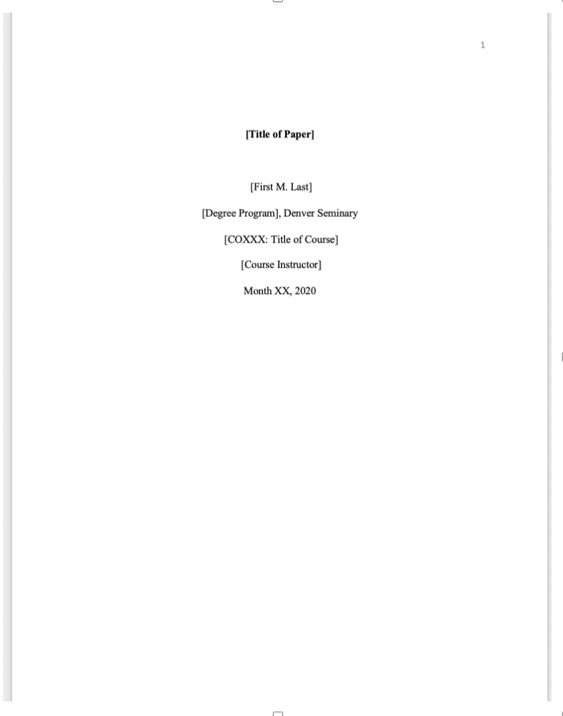
Chapter Two
Paper Elements and Format
Page number appears on title page in header
First M. Last (include middle initial)
Course number and title
Course Instructor
Date in this format: Month XX, Year
Title Page
“Elements of the title page are double-spaced, and an additional double-spaced blank line appears between the title and byline” (2.21).
Title of Paper: title case, bold, centered, and positioned in the upper half of the title page.
Author affiliation (student’s degree program and institution) e.g., MA-Counseling, Denver Seminary
Note: this title page template is available for download on the Writing Center’s Resources page
3

Slide 4
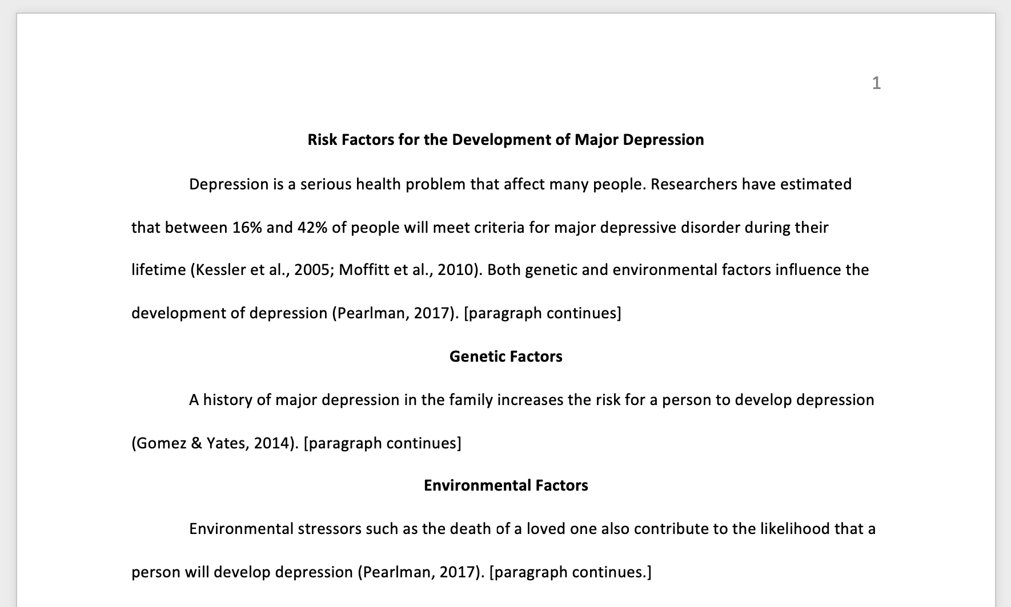
Chapter Two
Paper Elements and Format
Format for First Page of Text
Text begins on page 2.
The title of your paper in bold is your first heading. As the first paragraph is assumed to be your introduction, do not use “Introduction” as a heading.
Unless your introduction requires subheadings, your next heading will also be a level 1 heading (bold, centered).
Slide 5 shows formatting for up to five levels of heading.
4

Slide 5
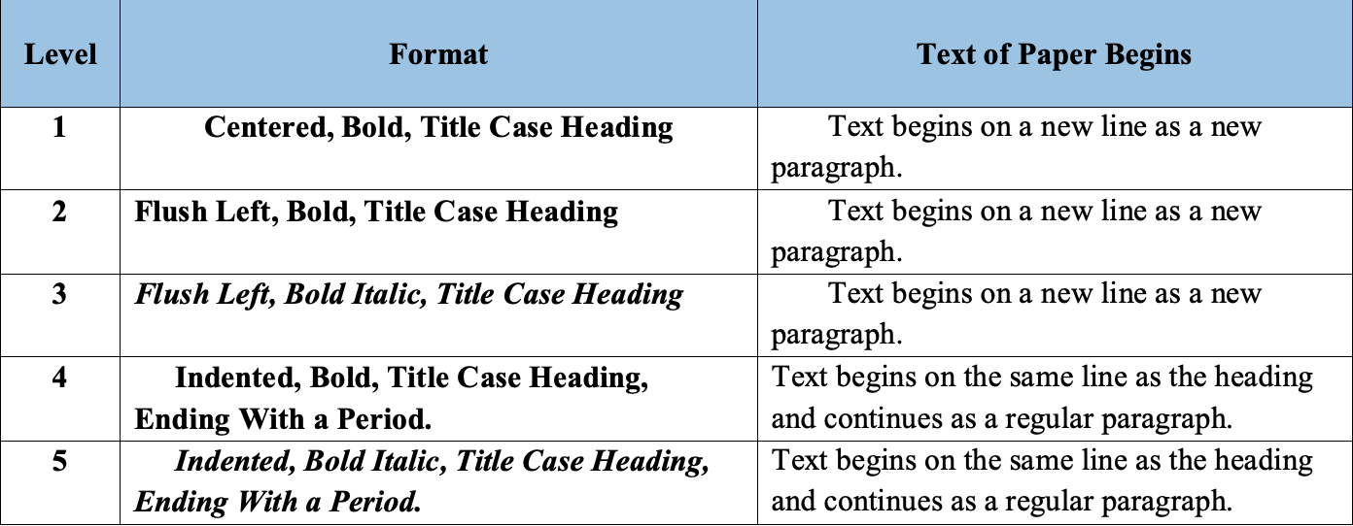
Chapter Two
|
Paper Elements and Format
Heading Levels (2.27):
5

Slide 6
Chapter Two
|
Paper Elements and Format
Other Things You Need to Know
Sample student papers are provided starting on p. 61.
Your paper’s “page count” refers to pages of text, not the title page or references.
Do not include a running head.
The APA manual provides flexibility on font requirements; the following are specifically recommended (2.19):
  11-pt: Calibri, Arial, or Georgia
  12-pt: Times New Roman
6

Slide 7
|
Chapter Six
Mechanics of Style
Lists (6.49-6.52)
The 7th edition provides updated guidelines on formatting lists (lettered, numbered, bulleted)
What You Need to Know
Use a “serial” (or “Oxford”) comma
  When a list within a sentence contains three or more items, use a serial comma before the final item (e.g., wisdom, stature, and favor with God and with people)
  If any item in a list within a sentence of three or more items already contains commas, use semicolons instead of commas between the items (e.g., New York; Chicago; Washington, D.C.; and Denver)
7

Slide 8
|
Chapter Six
Mechanics of Style
Lists (6.49-6.52)
Formatting Lettered Lists
Identify elements in a series with lowercase letters in parentheses to help readers understand the parallel items in a complex list. Use commas and semicolons as described on slide 22.
Our sample organization used a model that featured the following sequential stages: (a) analysis, (b) specification, (c) design, and (d) implementation.
Example of a lettered list:
8

Slide 9
|
Chapter Six
Mechanics of Style
Lists (6.49-6.52)
Formatting Numbered Lists
Use a numbered list to display complete sentences or paragraphs in a series such as itemized conclusions or steps in a procedure. (Use a lettered or bulleted list if the items are phrases.) Capitalize the first word of any sentence and end with punctuation. Double space the list.
We addressed the following research questions:
What research methodologies are used?
How are psychologists trained?
How are training outcomes assessed?
Example of a numbered list:
9

Slide 10
|
Chapter Six
Mechanics of Style
Lists (6.49-6.52)
Formatting Bulleted Lists
As numbered lists might connote unwarranted ordinal position (e.g., chronology or importance), bulleted lists achieve the same effect without the implication of ordinality. Items can be complete sentences or items that are phrases. Double space the list (not shown here).
If items are complete sentences, begin each bulleted sentence with a capital letter and end with punctuation:
Social psychologists could use these methods to improve research on emotional experiences.
For items that are phrases, begin each bulleted item with a lowercase letter:
learning the rules of the game
being aware of who possesses power
working harder
10
For items that contain both phrases and sentences in bulleted lists, see examples in 6.52.

Slide 11
|
Chapter Eight
Works Credited in the Text
In-Text Citations
What You Need to Know
Use the author-date citation system to cite references in the text.
Each work used in a paper has two parts: an in-text citation and a corresponding reference list entry (see Figure 8.2). (Reference list entries are covered in chapters nine and ten.)
Only the author and date information from the reference are used in in-text parenthetical and narrative citations.
11

Slide 12

|
Chapter Eight
Works Credited in the Text
In-Text Citations
Year omitted here; no parenthetical cite needed
Helpful Tips
Author name and year
In general, include the author and date in every in-text citation. If you need to repeat a citation, repeat the entire citation.
However, the year can be omitted from a citation when multiple narrative citations to a work appear within a single paragraph (8.16) (see example).
Example:
Polk (2016) examined how media coverage influences public perception of the level of agreement among experts. Polk provided participants with quotations from real movie reviews that critics either loved or loathed. He found that participants better appreciated the level of expert consensus. These findings show that providing both viewpoints when the majority of experts agree may lead to a false sense of balance (Polk, 2016; Fritz, 2015).
Year always included in parenthetical cites
12

Slide 13
|
Chapter Eight
Works Credited in the Text
In-Text Citations
Number of Authors to Include (8.17)
In-text citations have been simplified and made easier: for works with three or more authors, include the name of only the first author and the abbreviation “et al.” in every in-text citation, even the
first time a citation appears.
Author type | Parenthetical citation | Narrative citation
One author | (Luna, 2020) | Luna (2020)
Two authors | (Salas & D’Agostino, 2020) | Salas and D’Agostino (2020)
Three or more | (Martin et al., 2020) | Martin et al. (2020)
Group author with abbreviation First citation Subsequent citations | (National Institute of Mental Health [NIMH] (2020) (NIMH, 2020) | National Institute of Mental Health (NIMH, 2020) NIMH (2020)
Group author without abbr. | (Stanford University, 2020) | Stanford University (2020)
  Therefore, both first and subsequent citations would be:
    Smith et al. (2019) or (Smith et al., 2019)
13
Table 8.1, page 266

Slide 14
|
Chapter Eight
Works Credited in the Text
In-Text Citations
Group Authors (8.21)
If a reference has a group author, you may abbreviate the name of the group if it is well-known, would avoid cumbersome repetition, or appears at least three times in the paper.
  Provide the full name on the first mention in the text, followed by the abbreviation.
  If the group name first appears in a parenthetical citation, include the abbreviation in square brackets, followed by a comma and the year:
    (National Institute of Mental Health [NIMH], 2017)
  In the reference list entry, do not abbreviate the group name. Spell out the full name.
    National Institute of Mental Health. (2017, January). Understanding and overcoming opioid abuse.
    https://nimh.nih.gov/research
14

Slide 15
|
Chapter Eight
Works Credited in the Text
The following works require special approaches to citing:
Type Requiring a Special Approach | Guidance on Creating a Citation
Personal interview (8.7) | Cite as personal communication (see below, 8.9)
Research participant interview (8.7) | These interviews do not require a citation. However, information gathered can be presented and discussed in a paper according to the guidelines in 8.36.
Classroom or intranet resources (8.8) | Cite the works (e.g., PowerPoint, lecture, Moodle) using the formats in chapter 10 which are organized by reference group and category.
Personal communications (8.9) This category also includes and explains how to present Traditional Knowledge and Oral Traditions of Indigenous Peoples | Works that cannot be recovered (e.g., emails, texts, personal interviews, etc.) are cited as personal communications and listed in the text only. Provide the name and date in a parenthetical cite. Narrative: A. J. Paradis (personal communication, August 8, 2020) Parenthetical: (J. H. Matthews, personal communication, October 14, 2020)

Slide 16
|
Chapter Eight
Works Credited in the Text
General Guidance on Quotations
What You Need to Know
  Quoting is discouraged: “It is best to paraphrase sources . . . rather than directly quoting them” (8.25).
  “When quoting directly, always provide the author, year, and page number of the quotation in the in-text citation in either parenthetical or narrative format . . .” (8.25).
  Designate the page number or range in the following ways:
    Single page: “p.” (e.g., p. 24).
    Multiple pages: “pp.” (e.g., pp. 34-36).
    Discontinuous: (e.g., pp. 67, 72).
    No page numbers? Provide another way to locate the quoted passage (see 8.28)
16

Slide 17
|
Chapter Eight
Works Credited in the Text
Guidance on Short Quotations
What You Need to Know
  Short quotations: if a quotation consists of fewer than 40 words, incorporate it into the text and enclose it within double quotation marks (8.26).
“Even smart, educated, emotionally stable adults believe superstitions that they recognize are not rational,” as exemplified by the existence of people who knock on wood for good luck (Risen, 2016, p. 202).
Place the parenthetical cite at the end of the sentence rather than after the quote.
The period marking the end of the sentence follows the citation for a short quotation.
17

Slide 18
|
Chapter Eight
Works Credited in the Text
Guidance on Block Quotations
What You Need to Know
Double space the block quote
Block quotations (40 words or more):
    If a quotation contains 40 words or more, treat it as a block quotation.
    Start a block quotation on a new line and indent the whole block .5” (half inch) from the left margin.
    Double space the entire block quotation
    Do not enclose the quote in quotation marks (8.27).
Researchers have studied how people talk to themselves:
Inner speech is a paradoxical phenomenon. It is an
experience that is central to many people’s everyday
lives, and yet it presents considerable challenges to
any effort to study it scientifically. Nevertheless, a
wide range of methodologies and approaches have
combined to shed light on the experience. (Fenn,
2015, p. 957)
Indent .5”. Do not enclose block quotation in quote marks.
The period is placed after the quotation rather than the citation in a block quotation.
Include the page number.
18

Slide 19
Chapter Eight
Works Credited in the Text
  Modifying Quotations (more in 8.29-8.31)
What You Need to Know
    If you omit material, indicate missing words with three periods (four for a sentence break) with spaces around each.
        “It seemed to me self-evident that one essential property of love, hate, fear . . . was attention to the object” (Lewis, 1946, p. 6).
    If you insert material, enclose new material in brackets.
        Fee (2012) noted that “those [adults] who read magazines or watch television shows may feel guilty about wasting time” (p. 214).
    If you add emphasis, enclose “emphasis added” in brackets.
        They emphasized that “it is important to remember that gossip helped our ancestors survive [emphasis added], and thus . . . one is faced with an opportunity to adapt (Fee, 2012, p. 215).
19

Slide 20
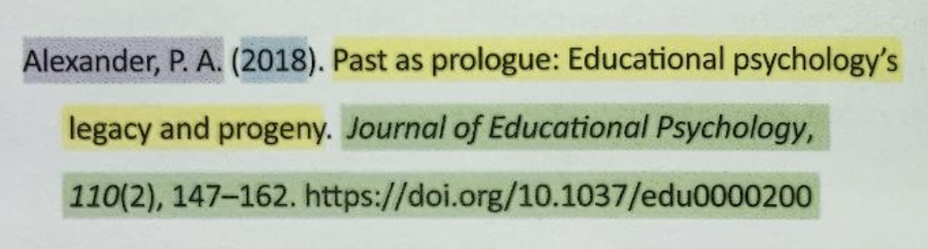
Chapter Nine |
Reference List
Chapter nine simplifies the guidelines for creating reference list entries with specific sections focusing on each reference element (author, date, title, and source) and the format and order of an APA Style reference list.
The four elements of a reference list each answer a question:
Author
Date
Title
Author: Who is responsible for this work?
Date: When was this work published?
Title: What is this work called?
Source: Where did I retrieve this work?
20
Source

Slide 21
Chapter Nine |
Reference List
Authors (9.7-9.12) | Dates | Titles | Sources
What You Need to Know About Authors
Use a serial comma before the ampersand (&) with three or more authors
  Author, A. A., Author, B. B., & Author, C. C.
Use one space between initials (see example above)
Provide surnames and initials for up to 20 authors
When a work has 21 or more authors, include the first 19 authors’ names, insert an ellipses (but no ampersand) and then insert the final author’s name (see Chapter 10, example 4)
For more information on authors, including what to do when there is no author, see 9.8-9.12.
21

Slide 22
Chapter Nine |
Reference List
Authors | Dates (9.13-9.17) | Titles | Sources
What You Need to Know About Dates
Do not use “retrieved from” or “accessed on” dates unless citing an unarchived (i.e., less stable) work that is likely or meant to change
Most references include only the year of publication, but works that are published more often may include year, month, and day.
If the publication date is unknown or cannot be determined, write “n.d.” in parentheses with no spaces.
  Gagnon (n.d.) or (Gagnon, n.d.)
22

Slide 23
Chapter Nine |
Reference List
Authors | Dates | Titles (9.18-9.22) | Sources
What You Need to Know About Titles
For works that stand alone (e.g., books, reports, webpages and websites), italicize the title, and capitalize it using sentence case
  Adoption-specific therapy: A guide to helping adopted children and their families thrive.
For works that are part of a greater whole (e.g., journal articles, edited book chapters), do not italicize the title or enclose in quotes; capitalize it using sentence case
  The virtue gap in humor: Exploring benevolent and corrective humor.
For standalone works, enclose in parentheses after the title any additional information given (e.g., edition, report number, volume).
  Nursing: A concept-based approach to learning (2nd ed., Vol. 1)
23

Slide 24
Chapter Nine |
Reference List
Authors | Dates | Titles | Sources (9.23-9.37)
What You Need to Know About Sources
Do not include publisher location information in the reference
  Bernstein, D. A. , & Borkovec, T. D. (1973). Progressive relaxation training: A manual for the helping professions. Research Press.
Include a location only for works associated with a specific location (e.g., a conference presentation)
Do not include Inc., Ltd., LLC, etc., in the publisher name
When the author is the same as the publisher, omit the publisher from the reference
  American Psychiatric Association. (2013). Diagnostic and statistical manual of mental disorders (5th ed.). https://doi.org.........
(Note: examples of how to cite specific types of sources in your references will be provided in the slides related to chapter ten.)

Slide 25
Chapter Nine |
Reference List
Helpful Tips
Authors | Dates | Titles | Sources (9.23-9.37)
When to include DOIs and URLs in your reference list (9.34)
Online Work… | Specific Type of Source | What to Include in Reference List
… has a DOI | All types (online/print) | Include DOI regardless of whether you used the online or print version
… has no DOI | Print | Do not include a DOI or URL
… includes both DOI and URL | Online | Include only the DOI
… has a URL but no DOI | Websites (excluding databases) | Provide URL (as long as link works for readers)
 | Academic research databases | Do not include URL or database information
 | Databases (either proprietary or have limited circulation) | Include the name of the database and the name of the work
 | Database that requires login | Provide URL of database or login page instead of URL
 | URL link no longer works | Follow guidelines for works with no source (9.37)
Notes:
p. 299

Slide 26
Chapter Ten |
Reference Examples
Chapter ten provides examples of references in APA Style and their corresponding in-text citations.
Chapter ten provides:
more than 100 examples of APA Style references grouped by category (e.g., periodicals, books, book chapters, reports, dissertations, social media, websites, etc.)
templates in each category so readers can understand the building blocks needed to create a reference for any type of work
corresponding parenthetical and narrative in-text citations for each reference
examples of variations when the author, date, title, or sources are atypical (see index pages 314-316 in chapter ten)
Helpful Tips
26

Slide 27
Chapter Ten |
Reference Examples
Citing Periodicals (10.1)
(journals, magazines, newspapers, etc.)
Author | Date | Title | Source Periodical Info DOI or URL
Author, A. A., & Author, B. B. | (2020, January 16). | Title of article. | Title of Periodical, 34(2), 5-12. | https://doi.org/xxxx
Example:
McCauley, S. M., & Christiansen, M. H. (2019). Language learning as language use: A cross-linguistic model of child language development. Psychological Review, 126(1), 1-51. https://doi.org/10.1037/rev0000126
Parenthetical citation:
Helpful Tip
(McCauley & Christensen, 2019)
There are many more examples of periodicals on pp. 317-321
Narrative citation:
McCauley and Christiansen (2019)
27

Slide 28
Chapter Ten |
Reference Examples
Citing Books (10.2)
Author | Date | Title | Source Publisher Info DOI or URL
Author, A. A. | (2020). | Title of book. | Publisher Name.
Author, A. A., & Author, B. B. | (2020). | Title of book (2nd ed.). | Publisher Name. | https://doi.org/xxxx
Editor, E. E. (Ed.). | (2020). | Title of book (E. E. Editor, Ed.). | Publisher Name.
Example:
Madigan, S. (2019). Narrative therapy (2nd ed.). American Psychological Association. https://doi.org/10.1027
Helpful Tip
Parenthetical citation:
(Burgess, 2019)
There are many more examples of books on pp. 321-325
Narrative citation:
Burgess (2019)
28

Slide 29
Chapter Ten |
Reference Examples
Citing Chapter in Edited Book (10.3)
Author | Date | Title | Source Edited book info DOI or URL
Author, A. A., & Author, B. B. | (2020). | Title of chapter. | In E. E. Editor (Ed.), Title of book (3rd ed., Vol. 2, pp. 3-13). Publisher Name. | https://doi.org/xxxx
Example:
Weinstock, R., Leong, G. B., & Silva, J. A. (2003). Defining forensic psychiatry: Roles and responsibilities. In R. Rosner (Ed.), Principles and practice of forensic psychiatry (2nd ed., pp. 7-13). CRC Press.
Helpful Tip
Parenthetical citation:
(Weinstock et al., 2003)
There are many more examples of edited books on pp. 326-329
29
Narrative citation:
Weinstock et al., (2003)

Slide 30
Chapter Ten |
Reference Examples
Citing Reports (“Gray Literature,” 10.4)
(press releases, grants, policy briefs, etc.)
Author | Date | Title | Source Publisher info DOI or URL
Author, A. A., & Author, B. B. | (2020). | Title of report (Report No. 3). | Publisher Name. | https://doi.org/xxxx
Example:
National Cancer Institute. (2018). Facing forward: Life after cancer treatment (NIH Publication No. 18-2424). U.S. Department of Health and Human Services, National Institutes of Health. https://www.cancer.gov/publications/patient-education/life-after-treatment.pdf
Helpful Tip
Parenthetical citation:
(National Cancer Institute, 2018)
There are many more examples of reports on pp. 329-331
Narrative citation:
National Cancer Institute (2018)
30

Slide 31
Chapter Ten |
Reference Examples
Citing Less Common Sources
Helpful Tips
See the following sections in chapter ten for guidance on citing these sources:
conference sessions and presentations (10.5)
dissertations and Theses (10.6)
reviews of books, films, TV shows, albums etc. (10.7)
unpublished and informally published works (10.8)
tests, scales, and inventories (10.11)
social media such as tweets, Facebook posts and pages, Instagram (10.15)
31

Slide 32
Chapter Ten |
Reference Examples
Citing Audiovisual Media
The formats for A/V media references follow a pattern based on whether the work stands alone (e.g., films, TV series, podcasts, albums, etc.) or is part of a greater whole (e.g., episode, song)
10.12 provides examples for citing
  films/video
  TV series
  TED Talks
  webinars
  YouTube or other streaming video
10.13 provides examples for citing
  music albums
  single song
  podcast/podcast episode
  radio interview
  speech audio recording
32

Slide 33
Chapter Ten |
Reference Examples
Citing Lecture Notes & PowerPoint Slides
Lecture:
Canan, E., (2016, May 22). [Lecture notes on resource allocation]. Department of Management Control and Information Systems, University of Chile. https://uchile.academia.edu/ElseZCanan
Parenthetical citation:
(Canan, 2016)
Narrative citation:
Canan (2016)
The example below includes the database through which the PowerPoint was accessed.
PowerPoint:
Housand, B. (2016). Game on! Integrating games and simulations in the classroom [PowerPoint slides]. SlideShare. https://www.slideshare.net/brainhousand/game-on-iagc-2016/
Parenthetical citation:
(Housand, 2016)
33
Narrative citation:
Housand (2016)

Slide 34
Chapter Ten |
Reference Examples
Citing Webpages and Websites (10.16)
For webpages and websites, provide the most specific date possible. When the author name and the site name are the same, omit the site name from the source element. Do not include a retrieval date unless the content is designed to change over time and the page is not archived.
Author | Date | Title | Source Website Name URL
Author, A. A., & Author, B. B. | (2020). | Title of work. | Site Name. | https://xxxxxxxxx
Example:
Martin, C. M. (2016), December 29. Be kind to yourself: How self-compassion can improve your resiliency. Mayo Clinic. https://www.mayoclinic.org/health.xxxxxx
Helpful Tip
Parenthetical citation:
(Martin, 2016)
There are more examples of webpage and website variations on pp. 351-352
34
Narrative citation:
Martin (2016)

Slide 35
Chapter Ten |
Reference Examples
Citing the DSM-5 Manual (10.2*)
New Citation for the 2022 Text Revision:
Type of Reference | How to Cite the DSM-5-TR
Full reference | American Psychiatric Association. (2022). Diagnostic and statistical manual of mental disorders (5th ed., text rev.). https://doi.org/10.1176/appi.books.9780890425787
Specific entry in the DSM | American Psychiatric Association. (2013). Anxiety disorders. In Diagnostic and statistical manual of mental disorders (5th ed., text rev.). https://doi.org/10.1176/appi.books.9780890425596.dsm05
Parenthetical citations | (American Psychiatric Association, 2022)
Narrative citations | American Psychiatric Association (2022)
35
(*Chapter ten, example 32 has been updated online with the 2022 Text Revision)

Slide 36
|
Citing the Bible
(8.13, 8.28, 9.41-2)
What You Need to Know
APA cites the Bible like all religious and classical works with canonically numbered parts.
Italicize the title of the Bible in references and citations (e.g., New English Standard Bible)
Do not use italics when referring to the Bible or to versions of the Bible generally (e.g., the New Revised Standard Version, the Septuagint)
If a translation has been republished (e.g., King James Bible), include the republished date (see 9.41 and chapter 10, example 35).
An annotated version (such as a study Bible) would be treated as having an editor. (See slide 39 for examples.)
Bibles published as books follow the book reference format.
Bibles published as websites follow the webpage reference format.
36
Examples follow…

Slide 37
|
Citing the Bible
(8.13, 8.28, 9.41-2)
Sample In-Text Citations
Parenthetical citation examples:
“All things work together for good” (English Standard Version Bible, 2016, Rom. 8:28).
“The Lord is nigh unto them that are of a broken heart” (King James Bible, 1796/2017, Psa. 34:18).
Narrative citation examples:
According to Luke 2:52 (English Standard Version Bible, 2016), Jesus increased in wisdom. . . .
The benediction in Ephesians 3:20 (King James Bible, 1796/2011) states. . . .
37

Slide 38
|
Citing the Bible
(8.13, 8.28, 9.41-2)
Reference Templates and Examples
Standard Bible, one publishing date:
Version | Date | Source Publisher Info URL
Version of the Bible. | (Year). | Publisher Name.
Version of the Bible. | (2020). | Publisher Name. | https://doi.org/xxxx
English Standard Version Bible. (2001). Crossway.
Holman Christian Standard Bible. (2004). Holman Bible Publishers. Biblegateway.com
Standard Bible, two publishing dates:
Version | Date | Source | Original date
Version of the Bible. | (Year). | Publisher. | (Original work published [Year])
King James Bible. (2017). Thomas Nelson. (Original work published 1769)
38

Slide 39
|
Citing the Bible
(APA Style Blog)
Citing an Annotated Bible (e.g., Study Bible)
When a Bible has been annotated, the editor(s) appears in the author position.
Cite a portion of the annotated work using page numbers from the work
Author | Date | Title | Source Publisher Info URL
Editor, E. E. (Ed.). | (Year). | Version of Bible | Publisher Name.
Example:
Kaiser, W. C., Jr., & Garrett, D. (Eds.). (2006). NIV archeological study bible: An illustrated walk through biblical history and culture. Zondervan.
Parenthetical citation:
(Kaiser & Garrett, 2016, footnote to Gen. 1:12, p. 4)
39
Narrative citation:
Kaiser and Garrett (2016, footnote to Gen. 1:12, p. 4)

Slide 40
Questions?
Visit the Writing Center Webpages (Editing, Tutoring, & Resources):
Top Menu: tinyurl.com/DenSemWCMenu
Email the Writing Center: writingcenter@denverseminary.edu
Jana Matthews, Writing Center Coordinator
Created: July 2022
latest Reviewed: February 2024

