Slide 1
Writing & Citing with Academic Integrity
Turabian Webinar October 18, 2024
Jana Matthews – Denver Seminary Writing Center Coordinator

Slide 2
What is Academic Integrity?
The University of Melbourne defines academic integrity as:
Honesty, responsibility and the maintenance of academic standards in scholarship. Honesty in scholarship means that all academic work results from an individual student's own efforts and that credit is given to other peoples' ideas.

Slide 3
Components of Academic Integrity
Creating and expressing your own ideas in your work
Acknowledging all sources of information
Completing assignments independently or acknowledging collaboration
Adapted from https://policy.unimelb.edu.au/MPF1310/#section-0

Slide 4
Ten Tips to Improve your Writing

Slide 5
1. Start Early!

Slide 6
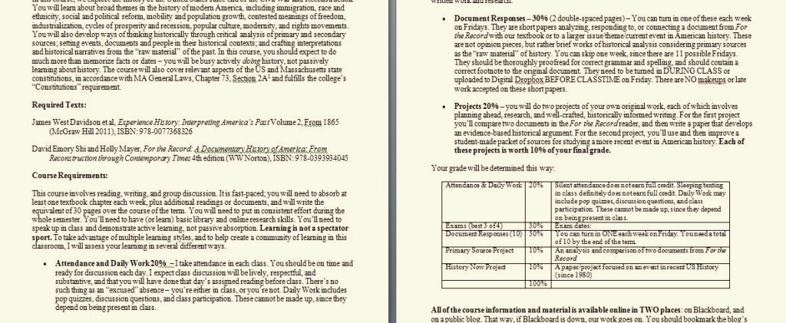
2. Read the assignment in the syllabus carefully
Notes:
and review the rubric if one is provided.

Slide 7
3. Locate Scholarly Resources
_{Use Library eReserves}
_{Use Research Guides}
_{Focus on primary sources}
Avoid using websites that end in .org
Notes:
Talk to Charlotte and watch the Research webinar from last week if you missed it

Slide 8
4. Take careful notes, including bibliographic information
Notes:
Cite sources correctly to build credibility.
More on this later

Slide 9
5. Spend time thinking about your research
Notes:
while you are doing it and before you begin writing.

Slide 10
6. Create a basic outline that includes the main points of your paper.
The Introduction states your thesis.
The body provides the evidence to support your thesis.
The conclusion summarizes the evidence and suggests key takeaways.
Notes:
it saves time and ensures structure.

Slide 11
7. Be Concise, Clear, and Avoid Complexity
Notes:
Prioritize clarity and simplicity over complexity. While scholarly writing often requires technical language, avoid unnecessary jargon or convoluted phrasing that might confuse your readers. Choose words that precisely convey your ideas without sacrificing accessibility. Tailor your language to your audience, keeping in mind that even experts appreciate clear and direct writing.
Additionally, maintain coherence by using clear transitions between ideas, and define any specialized terms you must use. Remember that clarity enhances persuasiveness—your argument is stronger when it’s easy to follow.

Slide 12
8. Revise, revise, revise.
Wait
Wait at least a day before editing.
Read
Read your paper aloud.
Rewrite
Rewrite awkward-sounding sentences.
Proofread
Proofread again.
Notes:
Your first draft is never perfect

Slide 13
9. Evaluate your research findings
Notes:
Often you will need to describe how they can be applied.

Slide 14
10. Seek feedback from mentors, peers, and the Writing Center
Notes:
From peers or mentors or the WC -- EARLY

Slide 15
What is Plagiarism?

Slide 16
Plagiarism is using a source without proper documentation
Copying others
Sources: another student’s paper, a book, an article, website content, commentaries, etc.
Copying yourself
Using your own work, such as a previous paper you have written, without citing it
restating or paraphrasing ideas without attribution
a quote taken from these works

Slide 17
A Word About Artificial Intelligence (AI) & Large Language Models (LLM)
Notes:
Examples are Chat GPT or Google Bard, but not PerfectIt or Grammarly, which are both based on a set of algorithms for error detection.

Slide 18
AI, LLMs, and Plagiarism
The Denver Seminary student handbook states:
Plagiarism includes using text generated through LLM AI platforms and then presented as one’s own (p. 44).
Students may not use LLM AI tools to generate original work (p. 45).

Slide 19
Artificial Intelligence & Large Language Models
Use LLM AI:
to discover keywords to use in searching databases
to proofread your work
Do Not Use LLM AI:
to write your paper or create content for your paper at any stage

Slide 20
Citing Sources in Turabian

Slide 21
Why Cite Sources?
To show readers that you have done your research
To give credit to others for the work they have done
To provide readers the ability to check your sources if there are questions
To point the way for others to build on your work
Notes:
Before we talk about specifics to citing in Turabian, let’s take a moment to review why we cite sources in the first place.

Slide 22
5 Citation Rules: When in Doubt, Cite It!
Five times you must cite:
When Referring to or mentioning a source in general: book title, article title, entire chapter, whole website, commentary, etc.
When Quoting from a source
When Paraphrasing or rewording a thought or concept from a source
Notes:
Probably my #1 rule for citing is, “When in doubt, cite it!”

Slide 23
5 Citation Rules: When in Doubt, Cite It!
When referring to your own thoughts or ideas. These citations will be formatted as unpublished manuscripts to avoid self-plagiarism.
When referring to or quoting scripture.

Slide 24
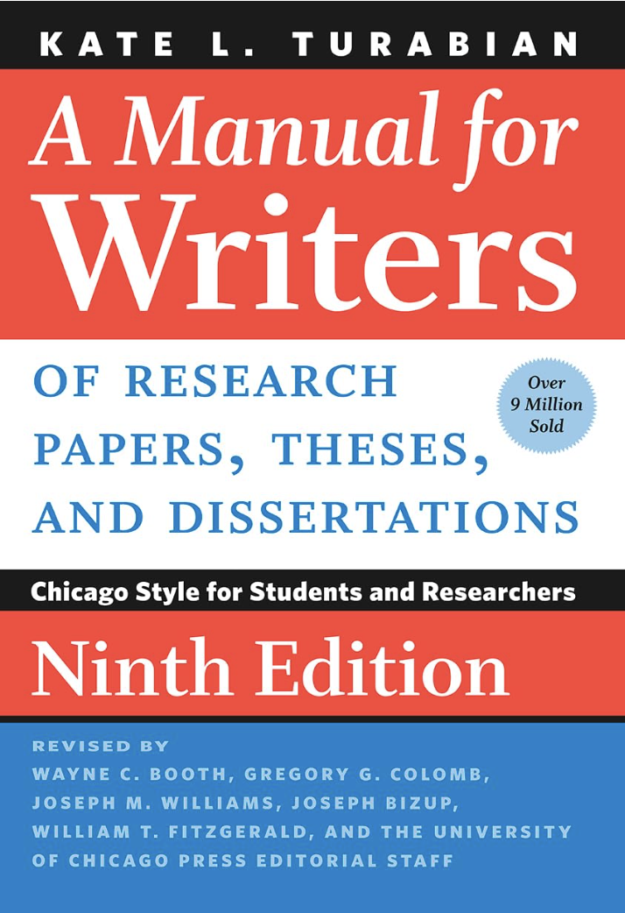
Tips on Turabian
An overview of
A Manual for Writers, 9th ed., 2018
Jana Matthews
Denver Seminary Writing Center Coordinator
Note: The following slides are adapted from the “Tips on Turabian 2.0” PowerPoint available on the Resources page.
Notes:
“Turabian” is an abbreviated way to refer to A Manual for Writers of Term Papers, Theses, and Dissertations by Kate L. Turabian.
The Turabian manual provides formatting guidelines for structuring your paper and citing your sources.
The Turabian manual is organized into the following three sections: Part 1: Research and Writing, Part 2: Source Citation, Part 3: Issues of Style
I’d like to now share with you some slides from the Tips on Turabian 2.0 PowerPoint that is available on our Resources page. So if you’ve reviewed that PowerPoint, these should look familiar.

Slide 25
How can I access the Turabian manual?
Hard copy: on reserve and in the reference section of the Denver campus library.
Online: The library provides online access to Turabian and The Chicago Manual of Style. You may access Turabian here and CMOS here here.
Kindle
Notes:
Pro tip: students may borrow a copy overnight if it is checked out within two hours of closing!)
CMOS is the professional version of Turabian.
Note: While the Writing Center offers many “quick-guide” resources on our Resources page to help students understand basic Turabian formatting, we recommend that students familiarize themselves with and consult the manual itself.

Slide 26
Which Turabian Citation Style to Use
Notes-Bibliography
Denver Seminary requires the use of the notes-bibliography style, which is used in the humanities. (The alternative is author-date, which is used in most sciences.)
Notes-bibliography style uses footnotes to cite sources and lists the sources used in a bibliography.
Notes-bibliography uses parenthetical citations only when citing scripture

Slide 27
Notes- Bibliography
Highlights of Notes-Bibliography Style
Superscripts: Indicate you have used a source by placing a superscript number at the end of the sentence in which you quote or refer to that source. Superscripts always follow punctuation:
Through “fostering the psychospiritual growth and health,” we can transform the depths of a person.¹
Footnotes: Cite the publication information of that source in a footnote:
¹ David Benner, Care of Souls: Revisioning Christian Nurture and Counsel (Ada, MI: Baker Books, 1998), 23.
Shortened cites: If you cite the same source again, use a shortened form with up to four words of the title:
² Benner, Care of Souls, 24.
Ibid.: After a shortened cite, use ibid. (Ibid. is Latin for “in the same source.” The word is not italicized in footnotes.)
³ Ibid.
⁴ Ibid., 25.

Slide 28
Writing & Citing in Turabian
Pro tip: download “Turabian Formatting Checklist” from the Resources page.
Formatting Checklist
Font | Times New Roman - black
Body | Font size: 12 pt. Line spacing: double space text, triple space above headings 1-inch margins on all sides Left justified (the right margin should be jagged)
Block Quotations | Format quotes of five or more lines as block quotations Line spacing: single space quotations with a blank line before and after Indent: all lines are indented ½ inch
Footnotes | Font size: 10 pt. Indent: first line of each footnote is indented ½ inch Line spacing: single space within each entry; blank line between entries
Bibliography | Font size: 12 pt. Line spacing: single within each entry, blank line (double space) between entries Indent runover lines ½ inch

Slide 29
Headings
Heading Level | Format Example Heading
First level | Centered, Boldface or Italic Type, Headline-style Capitalization Contemporary Art
Second level | Centered, Regular Type, Headline-style Capitalization What Are the Major Styles?
Third level | Flush Left, Boldface or Italic Type, Headline-style Capitalization Abstract Expressionism
Fourth level | Flush left, regular type, sentence-style capitalization Major painters and practitioners
Lengthy papers (6+ pages) generally need headings.
Unless you are writing a very long and complex paper (e.g., 20+ pages, a thesis), one or two heading levels are probably sufficient.

Slide 30
What to Capitalize
Capitalize:
the Bible, Holy Bible
the Holy Scriptures
the Word of God
Do not capitalize:
scripture or scriptural
biblical, biblical studies, biblical narrative

Slide 31
Words and terms from other languages
Italicize:
Foreign language terms and transliterations of Greek and Hebrew.
Examples:
The transliteration for “word” in Greek is logos.
The word for “rest” in the original Hebrew is nuwach.
Do not italicize:
Familiar terms (e.g., de facto, vis-à-vis) or Greek and Hebrew terms when written in Greek and Hebrew letters.

Slide 32
Citing Specific types of sources
The Writing Center provides citation guides that provide examples of how to cite the following:
Books: chapters of books, edited and/or translated books, ebooks, various editions (2nd, rev. ed., etc.), multi-volume series, etc.
Commentaries
Journal articles: hard copies and online
Website content (use caution and cite sparingly!)
The Bible
Class Lectures
Download two reference guides for citing sources on our Resources page:
Citing Common Sources in Turabian
Guidance for Research Papers
Notes:
I’m not going to go through examples of each of these right now, but I will show you these handouts a little bit later, and I will show you the slide on citing books to give you an idea of what the TOT PP offers. And we will go over how to cite the Bible.

Slide 33
Citing Books
Type of Source | Footnote Bibliography
Book, Basic order | ¹Author’s First and Last Names, Book Title, ed., trans., Series, Edition, vol. (City, ST: Publisher, Year), Pages. Author’s Last Name, Author’s First Name. Book Title. Ed. Trans. Series. Edition. Vol. City, ST: Publisher, Year.
Book (17.1) | ² Katie Kitamura, A Separation (New York: Riverhead Books, 2017), 25. Schüssler Fiorenza, Elisabeth. In Memory of Her: A Feminist Theological Reconstruction of Christian Origins. New York: Crossroad, 1984.
Editor or Translator in addition to author (17.1.1.1) | ³ Georg Wilhelm Friedrich Hegel, The Science of Logic, ed. and trans. George di Giovanni (Cambridge: Cambridge University Press, 2010), 642-43. Hegel, Georg Wilhelm Friedrich. The Science of Logic. Edited and translated by George di Giovanni. Cambridge: Cambridge University Press, 2010.
Pro tip: for examples of how to cite common sources, download a copy of “Citing Common Sources” on our Resources page.

Slide 34
Citing the Bible: In-text Citations
When quoting scripture: Put the full reference in a parenthetical cite. Identify the version.
“I will build you up again” (Jer. 31:4 NIV).
When referring to whole chapters or books: Spell out the names of the books.
Jeremiah 42-44 records the flight of the Jews to Egypt.
The Jews begin their flight to Egypt In Jeremiah 42.
When identifying passages by verse: Abbreviate the names of the books.
In Jer. 31:4 the prophet states, “I will build you up again.”
Note: Never write out the words “chapter(s)” or “verse” after the title of a biblical book, but use the form “Matthew 5,” or “Gal. 5:22-23.”

Slide 35
Citing the Bible: Abbreviations
Bible-related abbreviations:
Old Testament (OT), New Testament (NT)
Books: use either traditional or shorter abbreviations (pick one and be consistent).
For acceptable abbreviations, download “Citing the Bible in Turabian” from our Resources page.
Traditional example: 2 Chron.
Shorter example: 2 Chr
In the regular text of a paper, spell out “verse” and “verses”:
“In verses 8-10 we read. . . .”
But in parentheses or footnotes, abbreviate as v. or vv.
(v. 8), (vv. 8-10).

Slide 36
Citing the Bible: Versions of the Bible
Parentheses:
Note the version in parentheses using abbreviations:
“Jesus wept” (John 11:35 NIV).
Footnotes:
Footnote the first occurrence and identify the version. Thereafter, only identify the version when you diverge from your primary one. (See footnote example below.)
“Jesus began to weep” (John 11:35).¹
Bibliography
Do not cite the Bible in your Bibliography.
Exception: If citing study notes or other portions of a Bible, include the Bible in your bibliography.
¹ Unless otherwise noted, this and all subsequent references are from the NRSV.
Notes:
Study notes or other portions are formatted as a part of an edited collection (17.1.8.2).

Slide 37
Simplifying Turabian
Simplify Turabian in the Following Situations:
Information about translators and revisions may be excluded from footnotes and your bibliography.
Citing commentaries:
Single-author commentary: when an entire volume is written by a single author, you may treat it like a book, omitting the name of the series and series editor.
Multi-author commentary: when the author has contributed only a portion of a multi-author volume, treat it like a multi-author work.
This information was taken from “Guidance for Research Papers,” which you may download from our Resources page.

Slide 38
Writing Center Website

